Slide 1
Enhancing the Education and Wellbeing of Disadvantaged Toddlers through the Development of Training and Materials to Support Early Years Practitioners
Summary of the Case Study Impact Report
http://www.toddlerswellbeing.eu/
Helen Sutherland and Yngve Rosell
H.Sutherland@kingston.ac.uk
“This publication has been produced with the support of the Erasmus+ Programme of the European Union. The contents of this publication are the sole responsibility of the ToWe Project and can in no way be taken to reflect the views of the National Agency and the Commission.”

Slide 2
The aims of the Case Study Impact Report are to:
The Case Study Impact Report explores the impact that the ToWe Project has had upon the Early Years Practitioners in relation to their practice in supporting disadvantaged toddlers.
The Case Study Impact Report concentrates on specific instances, situations and identifies the interactive processes at work during the project. The impact assessment addresses the following:
How has the project supported Early Years Practitioners’ knowledge and understanding of disadvantaged toddlers?
How has the project equipped Early Years Practitioners’ with a range of tools to identify strategies to enhance toddlers’ wellbeing?
How have the Continuing Professional Development opportunities (training and job shadowing), focus group and discussion forum been effective in sharing practice and enhancing Early Years Practitioners’ skills?
How has the project impacted and influenced the Early Years Practitioners’ provision and practice in supporting the wellbeing of disadvantaged toddlers?

Slide 3
Why is the impact important?
It is about providing a positive vision for early years practitioners.
Looking forward develop future provision in support toddlers’ wellbeing.
Through reflection, engagement, empathy and encouragement and a shared approach.
‘The foundations for virtually every aspect of human development – physical, intellectual and emotional – are laid in early childhood. What happens during these early years (starting in the womb) has lifelong effects on many aspects of health and well-being– from obesity, heart disease and mental health, to educational achievement and economic status’
(Marmot, 2010:16).
(Sutherland and Mukadam, 2018)

Slide 4
Methodology
The ToWe project followed an interpretative qualitative paradigm with early years practitioners’ applying an action research model of observe, reflect, act, evaluate; to modify, investigate, explore and evaluate their own practice and development of solutions and strategies to support and improve provision for disadvantaged toddlers’.
Qualitative and Quantitative Data gathered through:
Questionnaires
3 Focus Group Interviews
Online reflective discussion fora
Group reflective sessions
Case Study Impact Report uses a case study methodology complementing the action research of the early years practitioners’ enabling investigation of the impact of the project by the Universities on early years practitioners’ provision and practice.
(Sutherland and Mukadam, 2018)

Slide 5
Focus Groups
3 focus groups interviews were held with each countries early years practitioners in:
May 2016
November 2016
July 2017
Recognition of good practice and areas for improvement
Introduction of new resources to support toddlers independence at mealtimes
Good feedback from colleagues to recommend changes to other settings
Key themes were identified within each focus group and the strategies introduced and the impact they had on Toddlers, Practitioners and Parents.
(Sutherland and Mukadam, 2018)

Slide 6
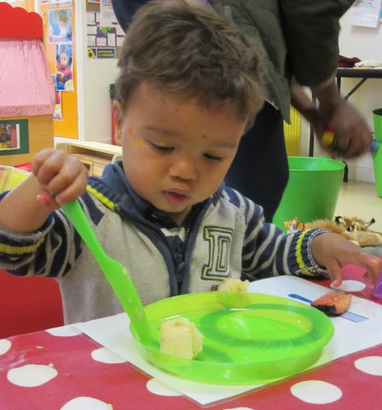
Example of the Impact
England:
An example of the impact of the project was the development and changes made to the snack time routine at the Children’s Centres. Child friendly serrated knives were purchased so that the toddlers could individually cut up their own fruit safely. Early years practitioners and teachers noted that the toddlers’ really enjoyed the snack time, as it promoted independence skills and learning opportunities.
(Sutherland and Mukadam, 2018)

Slide 7
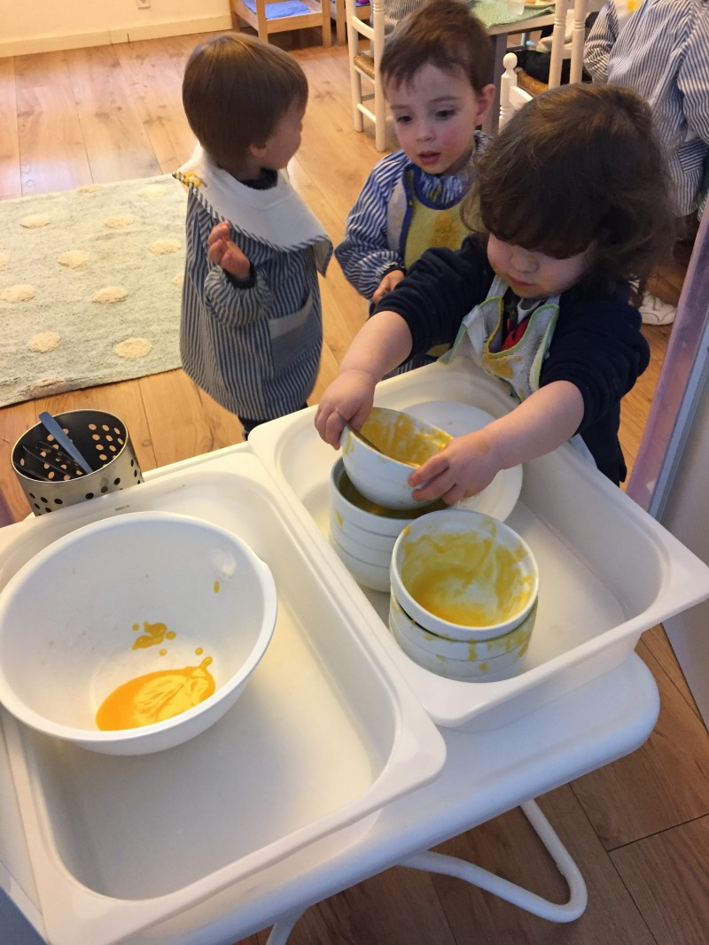
Example of the Impact
Norway:
An example of the impact of the project was that it was noted by the pre-school early years’ practitioners and teachers that the toddlers moving up to the pre-school room were demonstrating good independence skills and confidence, as the children were asking where to dispose of the food waste after meal times. So much so, the pre-school staff started to call these children the ‘ToWe children’ ‘because of the skills they had learned, the positive interaction between them and the wellbeing that the staff saw’
(Sutherland and Mukadam, 2018)

Slide 8
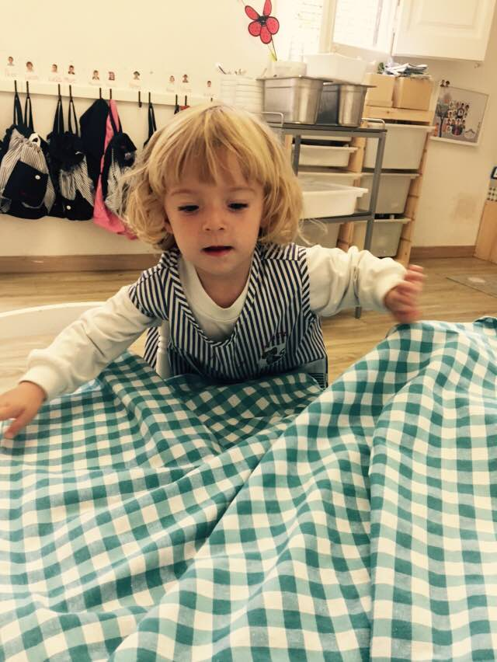
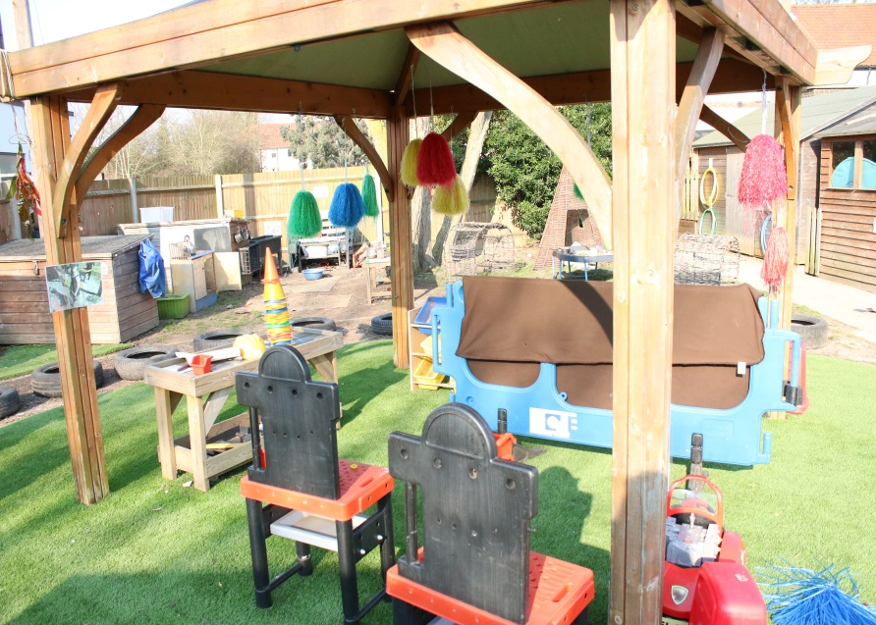
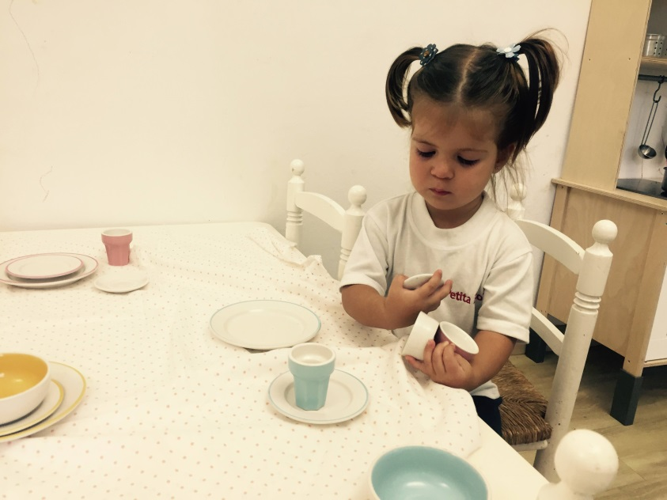
Example of the Impact
Spain:
An example of the impact of the project was that through continuous reflection, entrenched practice and ‘poor’ habits were identified and discussed recognising these attitudes and developing strategies to improve practice.
(Sutherland and Mukadam, 2018)

Slide 9
Job Shadowing and the Shared Experience
This involved two early years practitioners from each partner country, spending 5 days in each other’s settings. The programme included:
a taught session, from each university partner, on their country’s educational system and curriculum
observing each other’s practice to gain a better understanding of the role of the early years’ practitioners in relation to the country’s educational system, curriculum and provision
gaining a better knowledge and understanding of how the early years’ practitioners are supporting toddlers’ wellbeing through the different materials, tools and strategies in relation to the ToWe Projects Intellectual Outputs.

Slide 10
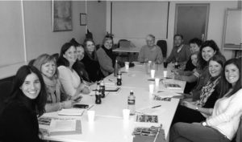
Job Shadowing and the Shared Experience
England:
When the children transition from inside to outside in England, there is often a rush to get shoes and coats on, and the practitioners and parents will often step in to help. In Norway I saw that extra time is factored in to the routine, so children can get ready independently. Some are able to dress themselves from a very young age and I saw a 14 month old girl put on her waterproof overalls all by herself. When I got back to my setting I made sure
that I shared this experience with
the parents, and tried to convey the
value of giving children time to do
things independently.
http://www.toddlerswellbeing.eu/news-and-events/

Slide 11
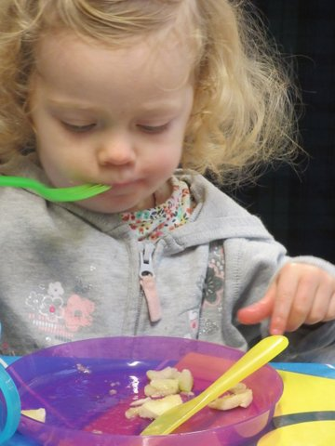
Norway:
At the “Little explorer session” there were families that were invited. We thought that the practitioners role in this session was challenging because there were so many disadvantaged children with parents that needed much guidance. We observed that the practitioner and the volunteer were being good role models for how the parents could interact with
their children in a supporting and developing
way during the session. The snack time was
prepared and arranged in a way that guided the
parents on how to support and encourage their
child's independence during meal times, they
used ToWe-strategies.

Slide 12
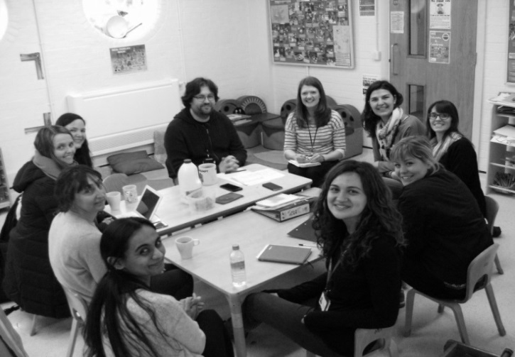
Spain:
I took the decision to travel to
Norway and the UK, and what
surprised me the most was to
find out that such different countries followed the same standards. I mean that in all the services you could feel the WELL-BEING of children, RESPECT, care during the MEALS, the observation and importance of the PLAY, ACCEPTANCE AND WORK WITH DIFFERENT LANGUAGES. But I think what was most clear was the willingness to IMPROVE OUR PRACTICE giving priority to the children’s WELFARE, offering them the best environment for their development with their individual needs.

Slide 13
What Next?
Schools and Settings developing:
An open dialogue of reflective sharing of experiences and expertise.
Knowledge and understanding of wellbeing, to inform and improve own and others practice and provision.
Relationships with parents to support their understanding of how to engage with their toddler.
Every high income country invests in its children: healthy, educated children are better able to fulfil their potential and contribute to society. By contrast, problems of child development often carry through into adulthood, with the resulting social costs accruing to the next generation (UNICEF, 2017: 4).
How can you use the manuals, audit tools and strategies from the ToWe Project to support early years practitioners in enabling them to be reflective, inspired and innovative in their practice and provision of supporting toddlers’ wellbeing?
(Sutherland and Mukadam, 2018)

Slide 14
References
Hogarth K. (2017) Learning from a Job-Shadowing Experience. Journal of the Comenius Association. Issue 26. pp. 22 – 24 [Online] Available at: http://www.associationcomenius.org/spip.php?article168&lang=fr (Accessed: 8th March 2018)
Marmot M. (2010) Strategic Review of Health Inequalities in England Post-2010. Fair Society, Healthy Lives: The Marmot Review Executive Summary. [Online] Available at: https://www.instituteofhealthequity.org/...marmot-review/fair-society-healthy-lives-executive-summary.pdf (Accessed: 9th February 2016)
Sutherland H. and Mukadam Y. (2018) Supporting Toddler Wellbeing in Early Years Settings: Strategies and Tools for Practitioners and Teachers. London: Jessica Kingsley Publishers
UNICEF (2017) Report Card 14: Building the Future Children and the Sustainable Development Goals in Rich Countries. [Online] Available at: https://www.unicef-irc.org/publications/pdf/RC14_eng.pdf (Accessed: 3rd October 2017)

Slide 15
Thank you Any questions?

